Slide 1
Patient engagement and medication management for diabetes & Hypertension

Slide 2
Welcome
The Patient Engagement and Medication Management for Diabetes and Hypertension webinar training series is focused on engaging patients and medication compliance alongside pharmaceutical programs and their staff.
Today
The Types and Importance of Pharmacy Services in Primary Care
Tue, Aug 21, 2018 3:00 PM - 4:00 PM MDT
Medication Reconciliation: An approach to ensure safe and effective medication management
Tue, Oct 16, 2018 3:00 PM - 4:00 PM MDT
Patient and medical staff engagement to encourage medication adherence
Tue, Dec 18, 2018 3:00 PM - 4:00 PM MST
Integrating Pharmacy Services into the Plan of Care
The series will be led by Dr. Holmes a clinical pharmacist and Assistant Professor of Pharmacy Practice and Family Medicine at Idaho State University (ISU).

Slide 3
The Types and Importance of Pharmacy Services in Primary Care
John T. Holmes, PharmD, BCPS
Assistant Professor
Departments of Family Medicine and Pharmacy Practice
Idaho State University
Notes:
Compressive view
First-time

Slide 4
Objectives
Describe the importance of medication management in primary care
Identify and classify different types of medication related problems (MRPs)
Explain different patient-care activities that may be preformed by pharmacy personnel in primary care clinics

Slide 5
Medication-Related Problems
~ 60% of US population takes ≥1 prescription medication annually
~15% take ≥ 5 prescription medications
Chronic conditions account for >90% of prescriptions filled in the U.S.
80% of medical treatments include medications
50% of prescribed medications not taken as directed
~33% of prescriptions never filled

Slide 6
Medication-Related Problems
Approximately 27% of patients experience ADE in ambulatory care setting
39% may be preventable or ameliorable
Estimated that 15% of older adults at risk for major drug-drug interaction
Medication-related problems cost ~$300 billion per year

Slide 7
Types of MRPs
Unnecessary drug therapy
Needs additional drug therapy
Ineffective drug
Dosage too low
Dosage too high
Adverse Drug Reaction
Medication Nonadherence
Cipolle RJ, Strand LM, Morley PC. Pharmaceutical Care Practice: The Patient-Centered
Approach to Medication Management, 3rd edition. New York: McGraw-Hill, 2012.

Slide 8
Sources of MRPs
Medication and regimen complexity
Poor communication
Provider <-> Pharmacist <-> Patient
Non-adherence
Prescribing errors
Inappropriate medication
Inadequate medication monitoring

Slide 9
Guideline-Based Care
Less than 50% of patients with diabetes and dyslipidemia receive guideline-based care
Less than 66% of patient with hypertension receive recommended guideline-based care

Slide 10
Pharmacists in Primary Care
Pharmacist role often thought of as dispensing medications
Underutilized member of the health care team
Highly accessible
Especially community/retail pharmacists

Slide 11
Clinical Pharmacist
“Health science discipline in which pharmacists provide patient care that optimizes medication therapy and promotes health, and disease prevention”
Practice in many different locations

Slide 12
Team-Based Care
Coordinated across multiple healthcare professionals, facilities, and systems
Continuous over time and between visits
Tailored to patients needs and preferences
Shared responsibility between patients and caregivers and healthcare professionals

Slide 13
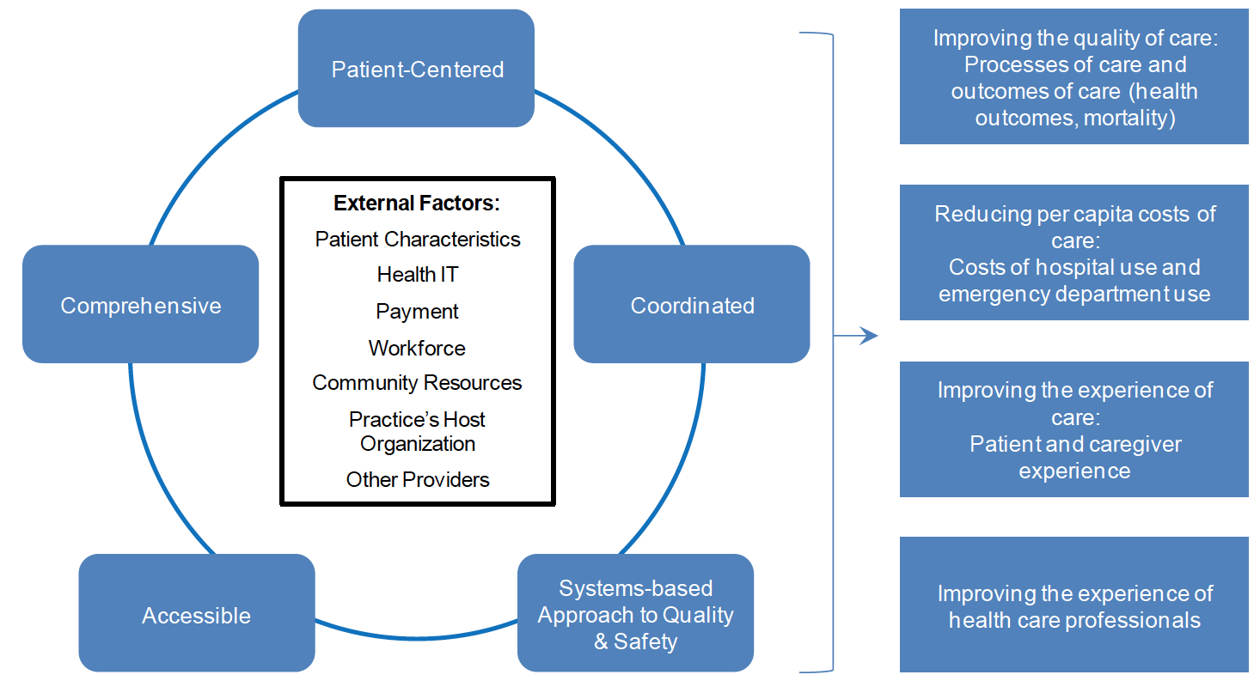
AHRQ

Slide 14
Benefits of Integrating Pharmacists
Improved adherence to medications
Improved quality of care
Improved blood pressure and blood glucose control
Improved cholesterol
Improved adherence to guideline-based care
Improved patient satisfaction
Lower healthcare costs

Slide 15
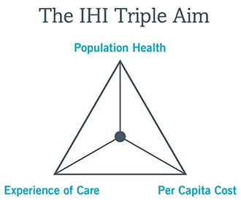

Slide 16
Pharmacist Education
Bachelor’s Degree / Pre-Requisites
Doctor of Pharmacy Degree (PharmD)
Pharmacy Residency (optional)
PGY1 Pharmacy Practice Residency
PGY2 Specialty Residency Programs
Fellowships
Board Certification

Slide 17
Pharmacy Technicians
Pharmacy Technician
Training
Certification
Roles

Slide 18
Primary Care Pharmacist Services
Collaborative Chronic disease management
Patient Prescription Assistance / Cost
Medication renewal / refill
Annual Medicare Wellness exams
Population-based care
Medication adherence
Medication Therapy Management
Clinical Resource

Slide 19
Pharmacist Functions
Patient assessment for medication-related factors
Order laboratory tests for monitoring drug therapy
Interpret data related to medication safety and effectiveness
Initiate or modify medication therapy plans
Provide information, education, and counseling about medications

Slide 20
Pharmacist Functions
Document care provided in patients’ record
Identify any barriers to patient adherence
Participate in multidisciplinary reviews of patients’ progress
Communicate with payers to resolve issues that impede access to medication
Communicate relevant issues to providers and team members

Slide 21
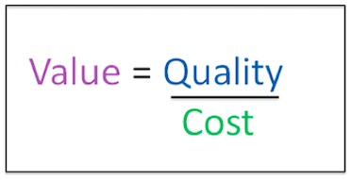
Funding
Pharmacists are not recognized Medicare Part B providers
“Incident-to” billing
Restricted to 99211 billing level – “Level 1 visit”
Fee-for-service vs. value-based reimbursement

Slide 22
Funding
Partnerships
Colleges of Pharmacy
Other clinics / institutions
Other Potential Revenue
340B
Medicare Annual Wellness Exams
Transition of Care
Medication Therapy Management ???

Slide 23
Pharmacist Provider Laws
Collaborative Practice Agreements
Formal agreement between pharmacist and physician
Outline delegated duties to the pharmacist
Allows pharmacists to select, implement, monitor and adjust appropriate medication therapies
Pharmacist Independent Prescribing
Statins in patients with diabetes
Others

Slide 24
Models of Pharmacy Services in Primary Care
Clinic pharmacist
Pharmacy technician
Community pharmacists
In-house dispensing pharmacist
Remote / tele-pharmacy

Slide 25
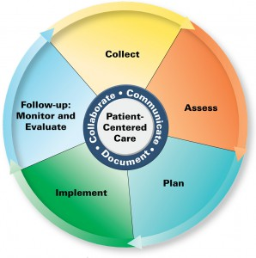
Pharmacist Care Process

Slide 26
Examples of Pharmacist-Provider Collaboration in Primary Care
The Asheville Project
Physician-Pharmacist Collaborative Care Model
CAPTION Study
The Diabetes Initiative Program

Slide 27
The Asheville Project
City of Asheville, NC
Partnership between physicians, health system, pharmacists, pharmacy associations, UNC, and the City of Asheville
Medication therapy management for patients with diabetes
Expanded to asthma, lipid management, CV health, and depression

Slide 28
The Asheville Project
Objective
Assess clinical, humanistic, and economic outcomes of community-based MTM for patients with chronic disease over 5 years
Participants
400 eligible employees from City of Asheville
Had to have either diabetes, high cholesterol, asthma, or depression
Certified/trained community and hospital pharmacists

Slide 29
The Asheville Project
Patients linked with pharmacist care manager
Attend American Diabetes Association education classes
Required to attend regular pharmacist and provider visits as well as regular labs
Waived co-pay for visits and meds associated with condition

Slide 30
The Asheville Project
Significant reduction in mean HbA1c
>50% of patients had improvements in HbA1c at each follow-up visit
Increase proportion of patients with HbA1c <7%
Reduced hospital and outpatient provider costs
Increased prescription costs
Decreased overall healthcare costs
City saves $4 on every $1 spent
Increased worker productivity

Slide 31
Physician-Pharmacist Collaborative Care Model

Slide 32
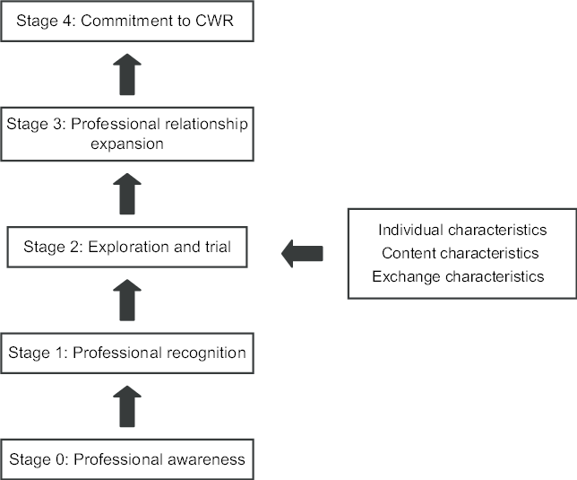

Slide 33
The CAPTION Study
Evaluate if a collaborative care model would be implemented in primary care to treat hypertension
Multisite
Idaho State University Family Medicine Residency clinic was a site
625 patients with uncontrolled hypertension

Slide 34
The CAPTION Study
Blood pressure control was 43% in intervention group versus 34% in control group
Significant reduction in BP
-6.1/2.9 mm Hg

Slide 36
Diabetes Initiative Program
Statewide (Tennessee) effort to evaluate effectiveness of pharmacist-provider collaboration for diabetes treatment
Collaborative Care
Collaborative Practice Agreement allowing for independent pharmacist prescribing
Co-visits with provider and pharmacist
Pharmacist visits then discussion with provider

Slide 37
Diabetes Initiative Program
206 adult patients with uncontrolled diabetes
12 months of follow-up
Significant reduction in mean HbA1c (1.16%)
Increase in proportion of patients with HbA1c <7%
12.75% → 36.7%
Decrease in proportion of patients with HbA1c >9%
34.15% → 16.5%

Slide 38
Resources
CDC Pharmacy Resources and Guides
https://www.cdc.gov/dhdsp/pubs/toolkits/pharmacy.htm
AHRQ Health Literacy Tools for Use in Pharmacies
https://www.ahrq.gov/professionals/quality-patient-safety/pharmhealthlit/tools.html
CDC Creating Community-Clinical Linkages
https://www.cdc.gov/dhdsp/pubs/docs/ccl-pharmacy-guide.pdf

Slide 39
Upcoming Webinars
August 21, 2018, 3:00 pm MDT Medication Reconciliation: An approach to ensure safe and effective medication management
October 16, 2018, 3:00 pm MDT Patient and Medical Staff Engagement to Encourage Medication Adherence
December 18, 2018, 3:00 pm MDT Integrating Pharmacy Services into the Plan of Care

Slide 40
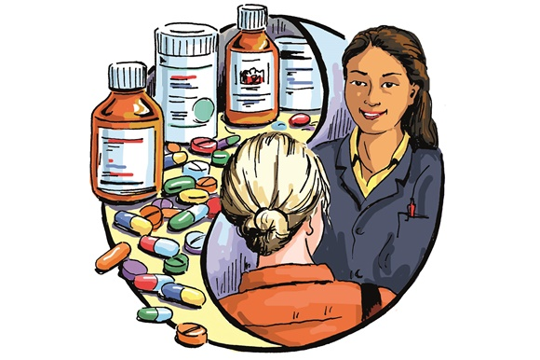
Questions?

